Slide 1
Our Life Project
By Emil , James and Niall
St Macartan’s College.

Slide 2
How we chose our theme.
The three of us sat down together to get some ideas for this project, we chose the theme “Life is a journey, not the destination!” because we thought our idea tied in with this title. We came up with the idea of making a sculpture of the word “Life” which we papier-mâchéd and then we made the sculpture of the heart we placed insulation board in between the two wooden boards which we stuck together using really strong glue.

Slide 3
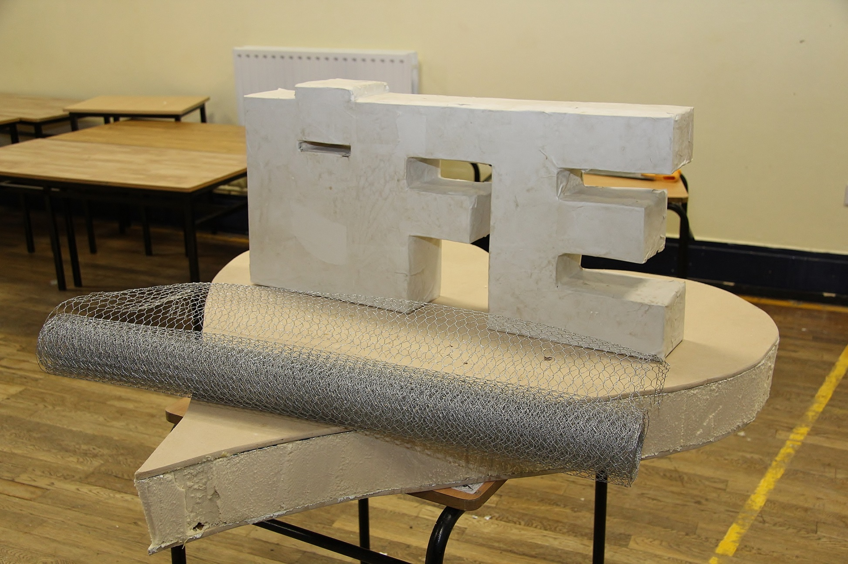

Slide 4
When our pieces were dry we got the chicken wire and constructed the road and the hills. The road represents the journey through life and the hills represent that life isn't always as easy as it seems and that we run into obstacles throughout life. Some of the hills are taller and wider than others which represents some obstacles can be harder for us to get past but with positive mental health we can do so.

Slide 6
Finishing touches
We painted our mountains with numerous types of green to add some depth into our scenery. We painted the sides of the base red to symbolise a healthy heart and healthy mental health. We painted the letters bright colours to lighten up the colour of our project. We then used L - shaped brackets to screw our letters down to the base of our project.

Slide 7
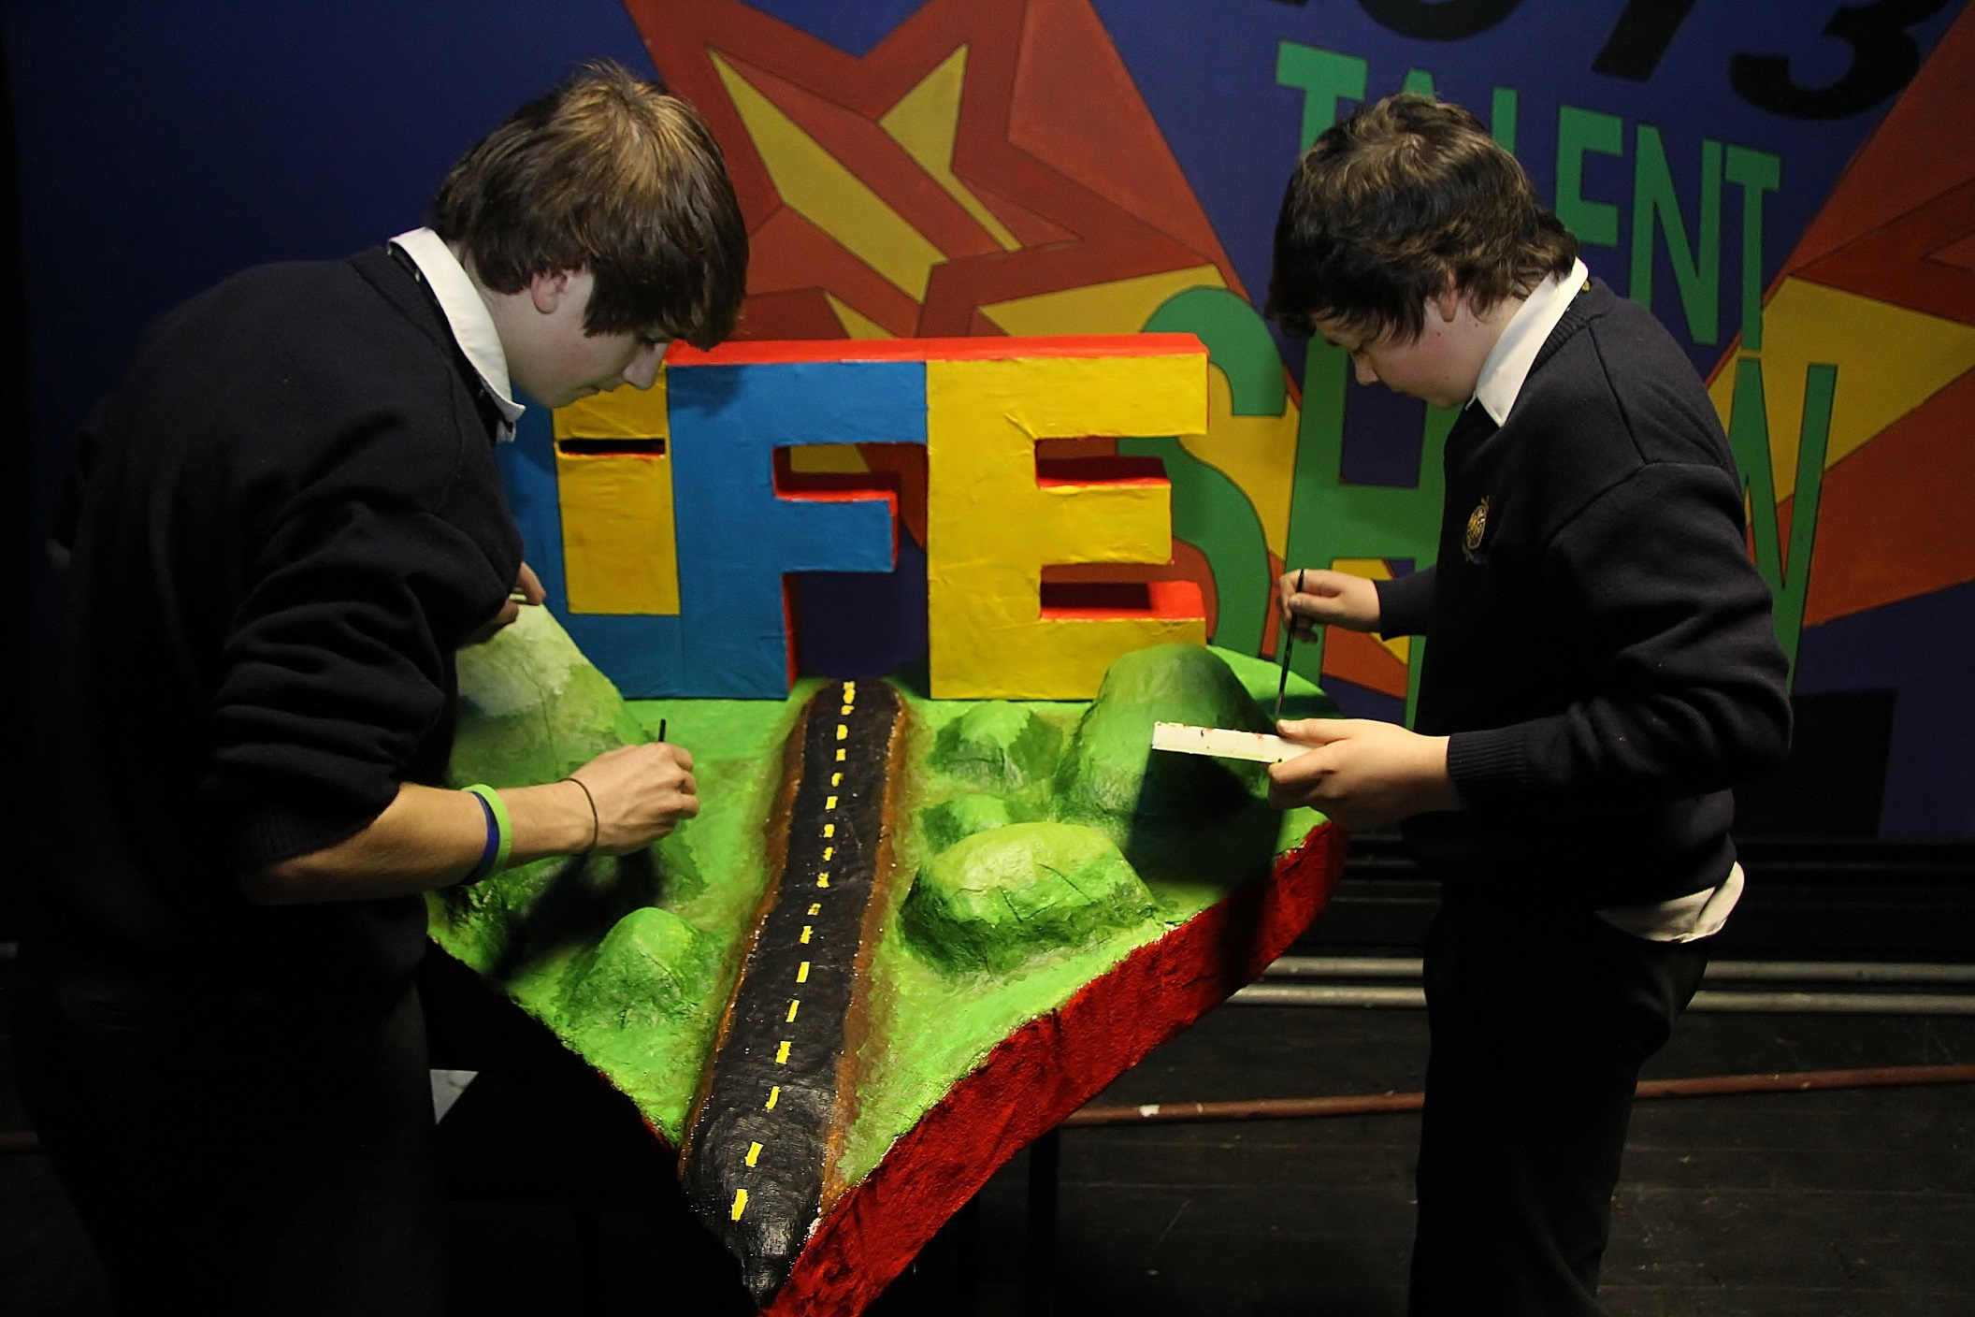

Slide 8
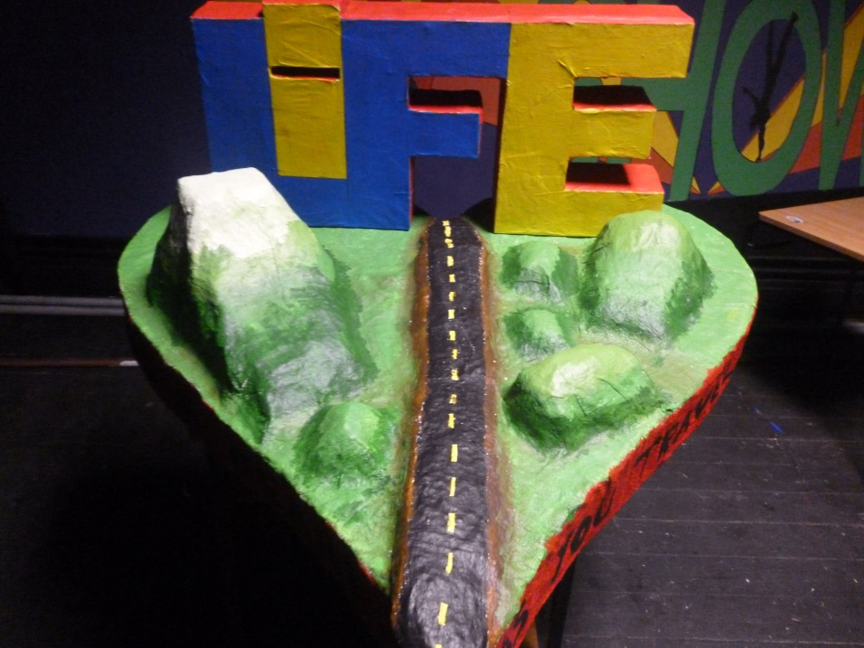
Overall opinion
We our very happy with how this project turned out in the end and we would like to thank our art teacher Mr Flynn for providing us with the materials to make it possible to have made this project.

